Slide 1
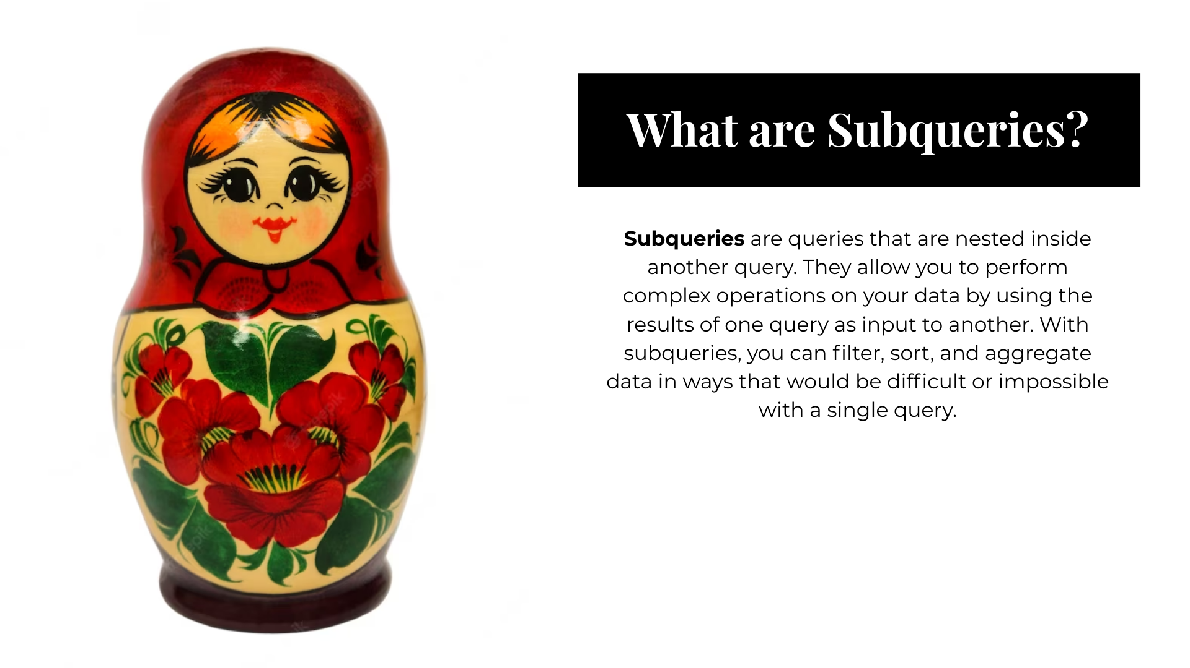
SUB QUERY

Slide 2

CORELATED SUB QUERY

Slide 3

Example for correlated sub Query
Display department wise who is earning greater than average salary of their department
select dept_name,emp_name,ctc
from department d inner join emps o
on d.dept_id = o.dept_id
where ctc > (select avg(ctc)
from emps i
where o.dept_id = i.dept_id)
Display department wise who is earning highest salary
select dept_name,emp_name,ctc
from department d inner join emps o
on d.dept_id = o.dept_id
where ctc = (select max(ctc)
from emps i
where o.dept_id = i.dept_id)
Display department wise who is earning lowest salary
select dept_name,emp_name,ctc
from department d inner join emps o
on d.dept_id = o.dept_id
where ctc = (select min(ctc)
from emps i
where o.dept_id = i.dept_id)

Slide 4
Example for correlated sub Query
Display department where we have employee exist
SELECT d.dept_id, d.dept_name
FROM department d
WHERE EXISTS (SELECT emp_name
FROM emps e
WHERE d.dept_id =
e.dept_id)
Display department where we have employee not exist
SELECT d.dept_id, d.dept_name
FROM department d
WHERE NOT EXISTS (SELECT emp_name
FROM emps e
WHERE d.dept_id =
e.dept_id)

Slide 5
Multicolumn sub query
select dept_name,emp_name,ctc
from department inner join emps o
on department.dept_id = o.dept_id
where (dept_name,ctc) in (select d.dept_name,max(ctc)
from department d inner join emps e
on d.dept_id = e.dept_id
group by d.dept_name)

